Slide 1
LEF Comparison Tool
Matthew Miller
James Exterkamp
Joshua Ashley
EE 584

Slide 2
LEF Comparison Tool
LEF data is generated in a random order
Makes diffs between LEF files practically useless
Identical source files can generate very different LEF files
LEF files can be sorted
No effect on data stored
Sorted LEF files can be diffed

Slide 3
LEF Files
Library Exchange Format (LEF)
LEF files are files used to store the physical layout of an integrated circuit
It is analogous to the layout view
It only stores the standard cell’s physical layouts. (Liberty stores more details of cell for simulation)
The file is organized into the following hierarchy
Cell
Cell Properties
Pins
Pin Properties
Port
Layers
Coordinates of Layers
Obstructions
Layers
Coordinates of Layer Obstructions

Slide 4
sortLEFdata.rb
AS IT STANDS:
Reads in LEF file
Checks file for errors, prints to screen
Optionally Reads in LIB file
Check for LIB errors
Compare LEF file against LIB file
Prints results to console and file.

Slide 5
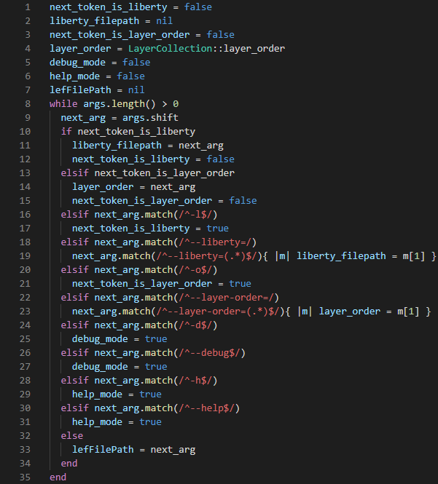
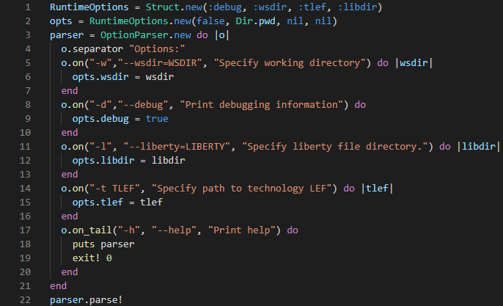
Changes to Options
Old
New
Ruby Standard Library
Expandable design
Clear intent
Structured to keep flags together

Slide 6
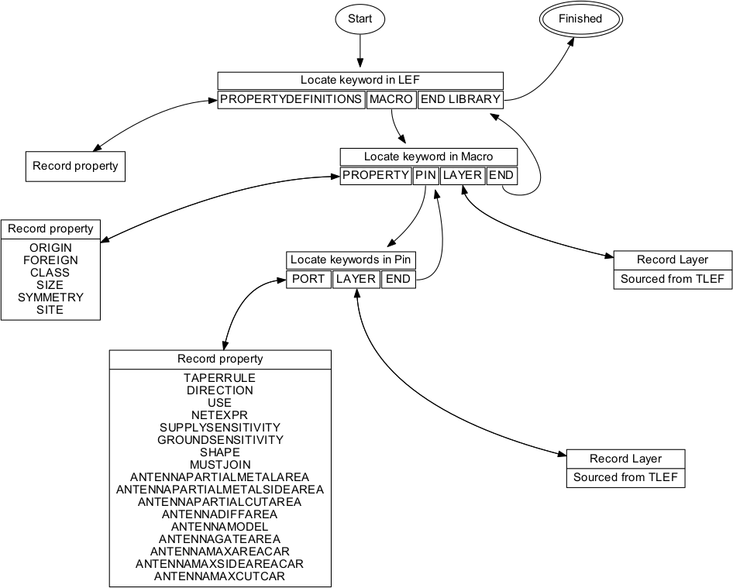
Parsing a LEF File

Slide 7
Improvements Made
Develop TLEF and TF parsing and checking
LayerCollection has hard coded valid layers.
Redirect list from TECHFILE.TF/TLEF parse
Allow passing a work-area and intelligently search within for LIB, and LEF files.
Ideal is that “wsdir” would be the only input option needing to be specified.
Multiple LEFS
Checking Pin Direction
Setup generic pin property checking between LEF and LIB.
New Options and Option Cleanup
The options should specify everything the ruby code is doing.
Cleanup and Annotate along the way
Better Logging
Shorter Methods

Slide 8
TLEF/TF Parsing
Given TLEF/TF filename, read layer names
Similar Parsing Structure
Only one instantiated per run, depending on DDC
If .tlef exists use that, otherwise use .tf
Parse chosen file, generate array of layers
Use these layers for LEF verification.

Slide 9
TLEF Parsing
User calls
User initializes with
TLEF_FILE object
TLEF_PARSE
Parses TLEF file into tlef_layers hash
Calls private methods
TLEF path
INITIALIZE
Verify file existence
Declare ALL instance variables
_MATCH_BEGIN_LAYER
Matches layer begin statement
Adds begin line number to tlef_layers hash
@tlef_fn
@tlef_layers
LAYERS
Returns layer keys from @tlef_layers
User calls
_MATCH_END_LAYER
Matches layer end statement
Adds end line number to tlef_layers hash
Layers Array

Slide 10
TF Parsing
User calls
User initializes with
TF_FILE object
TF_PARSE
Parses TF file into layers array
Looks for techLayers section
Scans lines, append layer until end of techLayers found.
TF path
INITIALIZE
Verify file existence
Declare ALL instance variables
@tlef_fn
@layers
LAYERS
@layers getter
User calls
@layers
@layers

Slide 11
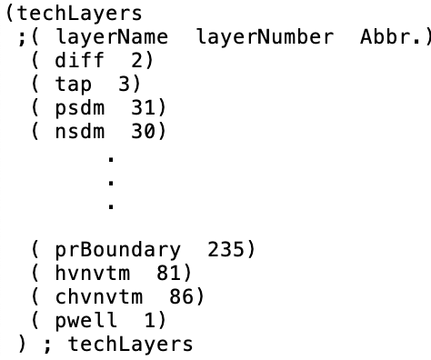
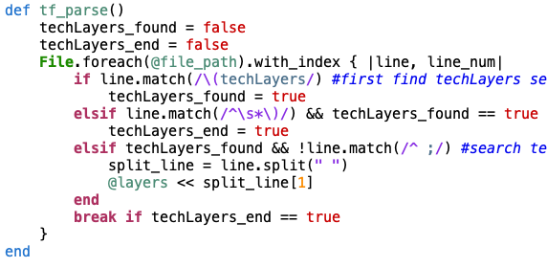
TF Code Sample
Techfile.tf
Parser

Slide 12
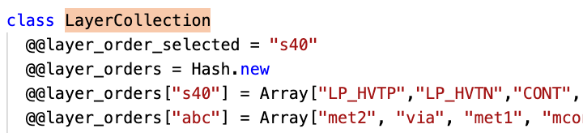
Layer Usage
Original LayerCollection has hard-coded layer arrays
Overwrite with TF/TLEF data when present.

Slide 13
DDC Scanning
User Call with proj_dir
DDC Scanner Class
Scan_for_files
Ddc_dirs = scan_for_dirs(proj_dir)
Passes corresponding ddc_dir/config to the scan_for classes
Scan_for_dirs
Does finds for directories “pnr”, “syn”, “config”
Returns DDC and config paths
Scan_for_lef_files
Scan_for_lib_files
Scan_for_tlef_files
Scans of ddc_dir[‘pnr’]
Scans of ddc_dir[‘syn’]
Scans of ddc_dir[‘config’]
DDC File hash

Slide 14
DDC File hash Structure
{
“DDC_dir”: {
‘lef’: [*.lef],
‘lib’: [*.lib]
},
“DDC_dir2”: {
…
}
“config”: {
‘tlef’: [*.tlef] << should only be one, could check that
}
}

Slide 15
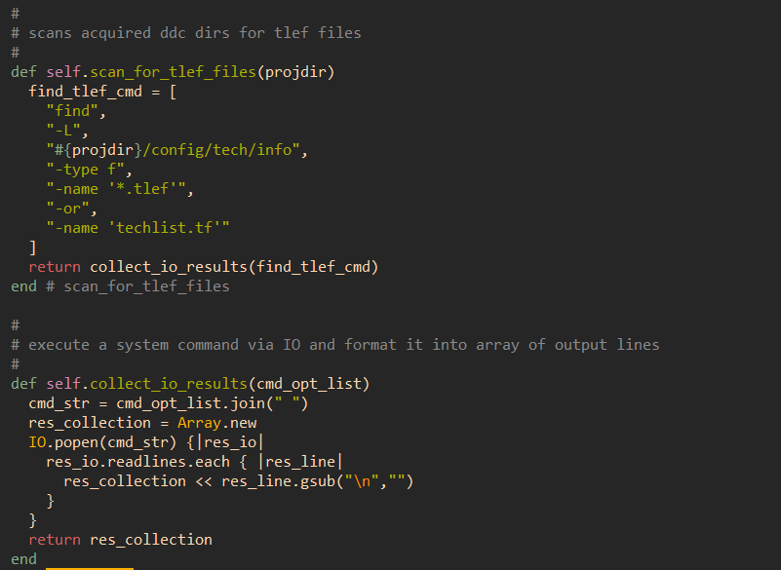
Finding Files

Slide 16
Pin Direction Checks
Pin direction exists under LEF and LIB pins
Need to take existing data structures and extract that info for each pin
Liberty_Pin does not extract any properties. Should extract “direction”.
Made to be generic

Slide 17
Liberty Rule Checks
Liberty Checker calls with:
(lef_pin, lib_pin, lib_prop_key)
LibRuleChecker class
Check_pin_value_in_lef
LEF Pin Properties: [“ DIRECTION INPUT ;\n”, “USE SIGNAL ;\n” ,” ANTENNAMODEL OXIDE1 ; \n” … ]
LIB Pin Properties: {“direction”=>”input” …}
Setup REGEXs to match LEF string to LIB key and LIB value
If regex searches not empty no error
Else, missing property error.

Slide 18
Current Checks
LEF-LEF
LEF_File
Reads in
Layer
Compare_to()
Compares number of coordinates
Compares coordinate values
Layer_collection
Compare_to()
Compares Layers
Pin
No lef-lef pin checks, lib-lef checks later
LEF-LIB
Check Lib for missing cells (1116)
Compare VALID LEF Size vs LIB Area (1132)
Check LEF that SIZE exists (1144)
Check LIB that AREA exists (1147)
Check that LEF pins found in LIB (1161)
Check that LIB cells found in LEF (1230)
Check that LIB pins found in LEF (1243)

Slide 19
Future improvements
LEF-DEF Manual specifies more syntax checks
Using LEF-DEF Manual Nov. 9, Ver. 5.7
More debug logging
Print separate errors to output files (ideally on lib-to-lib basis)
Do work outside of Object.initialize
Move liberty checker to LibRuleChecker
Better data structuring (JSON format and option)
LEF properties are stored in array of key-value strings rather than hash.

